Slide 1
HTML Fundamentals

Slide 2
Introduction to HTML
HTML is a MARKUP language
Using HTML tags and elements, we can:
  Control the appearance of the page and the content
  Publish online documents and retrieve online information using the links inserted in the HTML document
  Create on-line forms. These forms can be used to collect information about the user, conduct transactions, and so on

Slide 3
HTML syntax
<HTML>
<HEAD>
<TITLE>Welcome to HTML</TITLE>
<HEAD>
<BODY>
<H3>My first HTML document</H3>
</BODY>
</HTML>

Slide 4
HTML Tags
HTML tag is used to mark the beginning and end of an HTML document
  <HTML> . . . </HTML>
The HTML tag is comprised of:
  <ELEMENT ATTRIBUTE = value>
  Element - identifies the tag
  Attribute - describes the tag
  Value - the content that is assigned to the attribute

Slide 5
HTML Elements
HTML Elements
An HTML element is everything from the start tag to the end tag:
tart tag * | Element content | End tag *
<p> | This is a paragraph | </p>
<a href="default.htm"> | This is a link | </a>
<br />

Slide 6
HTML Attributes
HTML elements can have attributes
Attributes provide additional information about an element
Attributes are always specified in the start tag
Attributes come in name/value pairs like: name="value“
Below is a list of some attributes that are standard for most HTML elements:
Attribute | Value | Description
class | classname | Specifies a classname for an element
id | id | Specifies a unique id for an element
style | style_definition | Specifies an inline style for an element
title | tooltip_text | Specifies extra information about an element (displayed as a tool tip)

Slide 7
HTML Attributes sample
  <!DOCTYPE html>
  <html>
    <head>
      <style type="text/css">
        h1.intro {color:blue;}
        p.important {color:red;}
      </style>
    </head>
    <body>
      <h1 class="intro">Header 1</h1>
      <p>A paragraph.</p>
      <p class="important">Note that this is an important paragraph. :)</p>
    </body>
  </html>

Slide 8
HTML Attributes sample
  <!DOCTYPE html>
  <html>
    <head>
      <script type="text/javascript">
        function displayResult()
        {
        document.getElementById("myHeader").innerHTML="Have a nice day!";
        }
      </script>
    </head>
    <body>
      <h1 id="myHeader">Hello World!</h1>
      <button onclick="displayResult()">Change text</button>
    </body>
  </html>

Slide 9
Hyperlinks
  HTML Link Syntax
  <a href="url">Link text</a>
The target Attribute
<a href=“http://www.goole.com/” target="_blank">google page! </a>
It will open the linked document in a new browser window or a new ta

Slide 10
Hyperlinks - Attribute
The name Attribute
A named anchor inside an HTML document
  <a name="tips">Useful Tips Section</a>
Create a link to the "Useful Tips Section" inside the same document:
<a href="#tips">Visit the Useful Tips Section</a>
Or, create a link to the "Useful Tips Section" from another page:
<a href="http://www.docbao.com/html_links.htm#tips">
go to doc bao </a>

Slide 11
Basic Tags

Slide 12
Basic HTML elements
Header (H1 to H6) Tag
Paragraph Level Tags
Block Tags
Character Format Tags
List
Horizontal Rule <HR> Tag
Font Tag
IMG Tag

Slide 13
Structuring Text
Using Quotes
  <BLOCKQUOTE >
Preformatted text
  <PRE>
Grouping elements
  <DIV>…</DIV>
  <SPAN>…</SPAN>

Slide 14
Formatting
Physical formatting tags
  As mentioned above, a physical character tag controls how the characters are formatted. For instance, you might display some characters as bold or italic. Listing 1 displays some common physical character tags.
Logical formatting tags
  A logical character tag describes how the text is being used, not necessarily how it is formatted. Listing 3 displays common examples logical character tags.

Slide 15
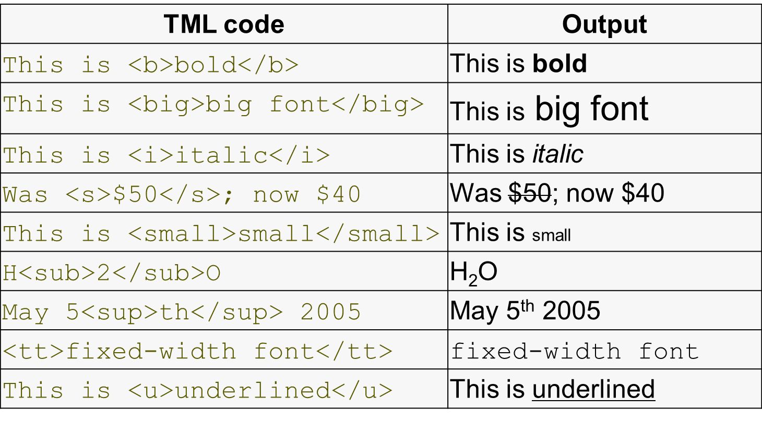
Physical Formatting Tags

Slide 16
Physical Formatting Tags
HTML code | Output
This is used for a short <cite>quote</cite>. | This is used for a short quote.
<code>y = m * x + b</code> | y = m * x + b
<del>Deleted</del> text | Deleted text
<dfn>definition</dfn> text | definition text
This is <em> emphasized </em>. | This is emphasized .
<ins>inserted</ins> text | inserted text
<kbd>code</kbd> sample | code sample
<samp>code</samp> sample | code sample
This is <strong>strong</strong>. | This is strong.
<var>program</var> variable | program variable

Slide 17
Horizontal Rule
<HR> Attributes
  align
  Width
  Size
  Noshade

Slide 18
Using Fonts
<FONT> … </FONT>
  Color
  Size
  Face

Slide 19
Adding Color
<HTML>
<HEAD>
<TITLE>Learning HTML</TITLE>
</HEAD>
<BODY BGCOLOR=lavender>
<H2><FONT COLOR = LIMEGREEN>Welcome to HTML</FONT></H2>
<P><FONT COLOR = RED>This is good fun</FONT></P>
</BODY>
</HTML>

Slide 20
Images in HTML Documents
GIF (Graphics Interchange Format) images (.GIF)
  Interlaced GIF format
  Transparent GIF images
JPEG (Joint Photographic Expert Group) images (.JPEG)
PNG (Portable Network Graphics)

Slide 21
Inserting Images
<IMG SRC=”URL”>
<IMG ALIGN=position SRC=”PICTURE.GIF”>
<IMG SRC=Flowers.jpg ALT=”Beautiful Flowers”>
<BODY BACKGROUND=bgimage.gif>
<BODY BACKGROUND=bgimage.gif BGPROPERTIES=FIXED>

Slide 22
Using Tables and Layers

Slide 23
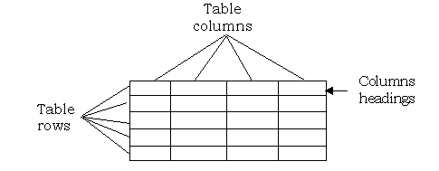
Layout of a Table

Slide 24
Elements Associated with Table
<TABLE> … </TABLE>
<TR> … </TR>
<TD> … </TD>
<CAPTION> … </CAPTION>
<TH> … </TH>

Slide 25
Creating Tables
<table border="1">
<tr>
<th>Header 1</th>
<th>Header 2</th>
</tr>
<tr>
<td>row 1, cell 1</td>
<td>row 1, cell 2</td>
</tr>
<tr>
<td>row 2, cell 1</td>
<td>row 2, cell 2</td>
</tr>
</table>

Slide 26
Add Cell Space
The CELLSPACING attribute defines the space between cells in pixels. The CELLPADDING attribute defines spaces within the table cell.
<TABLE BORDER = 2 CELLSPACING = 2 CELLPADDING = 6>

Slide 27
Merging Cells
  The COLSPAN and ROWSPAN attributes are used to create cells that span more than one column or row
  The COLSPAN attribute is used with the <TH> tag, while the ROWSPAN attribute is used with the <TD> tag

Slide 28
Formatting Data in the Cell
Align = left
Align = center
Align = right
Align = justify
Valign = top
Valign = middle
Valign = bottom
Valign = baseline
<TD ALIGN = right VALIGN = bottom>
Data Cell 1</TD>

Slide 29
Adding Java Applet
To display the applet, we need to create an HTML page that loads the applet file into the browser
<applet code = FirstApplet width=200 height= 200></applet>

Slide 30
Passing Parameters to Applet
It is possible to pass parameters to an applet using the <PARAM> tag in the HTML file
<PARAM name = “parameter name" value = “parameter value">

Slide 31
Using Forms

Slide 32
Introduction to Forms
Uses of Forms
  Collecting names, addresses, telephone numbers, e-mail addresses, and other information to register users for a service or event
  Gathering information for the purchase of an item. For example, if we want to purchase a book over the Internet, we would be required to fill in our name, mailing address, mode of payment, and so on

Slide 33
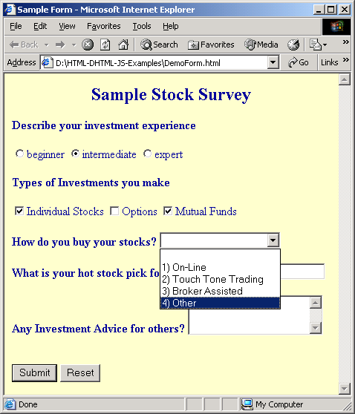
A Sample Form

Slide 34
Using Forms
The FORM element
  <FORM> … </FORM>
Form Attribute
  ACCEPT
  ACTION
  METHOD

Slide 35
HTML Input Element Attribute
The INPUT Element
  TYPE
  NAME
  VALUE
  SIZE
  MAXLENGTH
  CHECKED
  SRC

Slide 36
Input –Type Attribute
TEXT [ Default ]
CHECKBOX
RADIO
SUBMIT
RESET
IMAGE
BUTTON

Slide 37
Other Input Elements-1
The TextArea Element
  cols
  rows
  Size
  type
  Value
The BUTTON Element
  name
  value
  type

Slide 38
Other INPUT Elements-2
The SELECT Element
  Name
  size
  Multiple
The LABEL Element

Slide 39
Creating Forms
<form name="input" action="html_form_action.asp" method="get">
Username: <input type="text" name="user" />
<input type="submit" value="Submit" />
</form>

Slide 40
Q&A

